Slide 1
PERSONAL PROFILE
MR. BISWAJIT BORA
: LATE KONRAM BORA
: 21-09-1984
: MELAMORA GAON
P.O. MELAMORA, DIST. GOLAGHAT.
PIN – 785702, ASSAM
NAME OF THE FACULTY :
FATHER’s NAME
DATE OF BIRTH
PERMANENT ADDRESS
MOBILE NUMBER
: 6000399066
: biswajitthebora@gmail.com
Email-

Slide 2
PRESENT / OFFICE ADDRESS
: DO
:- H.S.L.C. ONWARDS
ACADEMIC QUALIFICATION
SL NO | EXAMINATION | BOARD / UNIVERSITY | SUBJECT | Year of Passing
1 | H.S.L.C. | S.E.B.A | Eng,Assamese,Math,Social Studies, Gen Science,Hindi | 2000
2 | H.S.S.L.C | A.H.S.E.C | Eng,Assamese,Pol.Sc,Eco,Education, Ad Assamese. | 2003
3 | B.A. | DIBRUGARH UNIVERSITY | POLITICAL SCIENCE | 2006
4 | M.A. | DIBRUGARH UNIVERSITY | POLITICAL SCIENCE | 2008
5 | SET | SLET COMMISSION,ASSAM | POLITICAL SCIENCE | 2015
6 | TET | L.P ,U.P. | POLITICAL SCIENCE | 2012

Slide 3
DATE OF JOINING : 17-08-2009
Provincialisation of Post : 01-01-2021
AREA OF SPECIALISATION – GROUP- C (INDIAN GOVT & POLITICS
PROFESSIONAL QUALIFICATION : SET (STATE ELIGIBILITY TEST)
OTHER QUALIFICATION :DOUBLE TET QUALIFIED L.P & UP (Teacher’s ELIGIBILITY TEST)
ORIENTATION / FACULTY INDUCTION PROGRAMME
ORGANIZED BY :
HUMAN RESOURCE DEVELOPMENT CENTRE, MIZORAM UNIVERSITY
DURATION- 02 NOV - 22 NOVEMBER, 2021 (GRADE - A)

Slide 4
ORIENTATION / FACULTY INDUCTION PROGRAMME/REFRESHER COURSE
02 NOV-22 NOV - 2021 | ORIENTATION/FACULTY INDUCTION PROGRAMME | MIZORAM UNIVERSITY | GRADE - A
22AUG- 4 SEPT-2023 | REFRESHER COURSE | MIZORAM UNIVERSITY | GRADE - A

Slide 5
NATIONAL LEVEL WEBINAR (PARICIPATED) : 2021-22
Use of Technology in Education:NEP 2020 | IQAC ,Karimganj College,Assam | 13th August 2021(5-7 p.m)
Democratic Decentralization and Rural Development in North East India | All Assam Pol Sc. Association | 25th September, 2021
Intellectual Property Rights | Pol Sc. Dept,Machkhowa Degree College, Dhemaji. | 18 September, 2021
INTERNATIONAL LEVEL WEBINAR : 2021
Fall Out From Taliban Takeover In Afganisthan | Centre For Ethnic Studies And Research(CESR)GUWAHATI | 20th August-2021
Ethnicity and Ethnic Mobilisation in North East India | Pol Sc Dept Haflong Govt College, in association with CESR,Guwahati. | 04 October, 2021

Slide 6
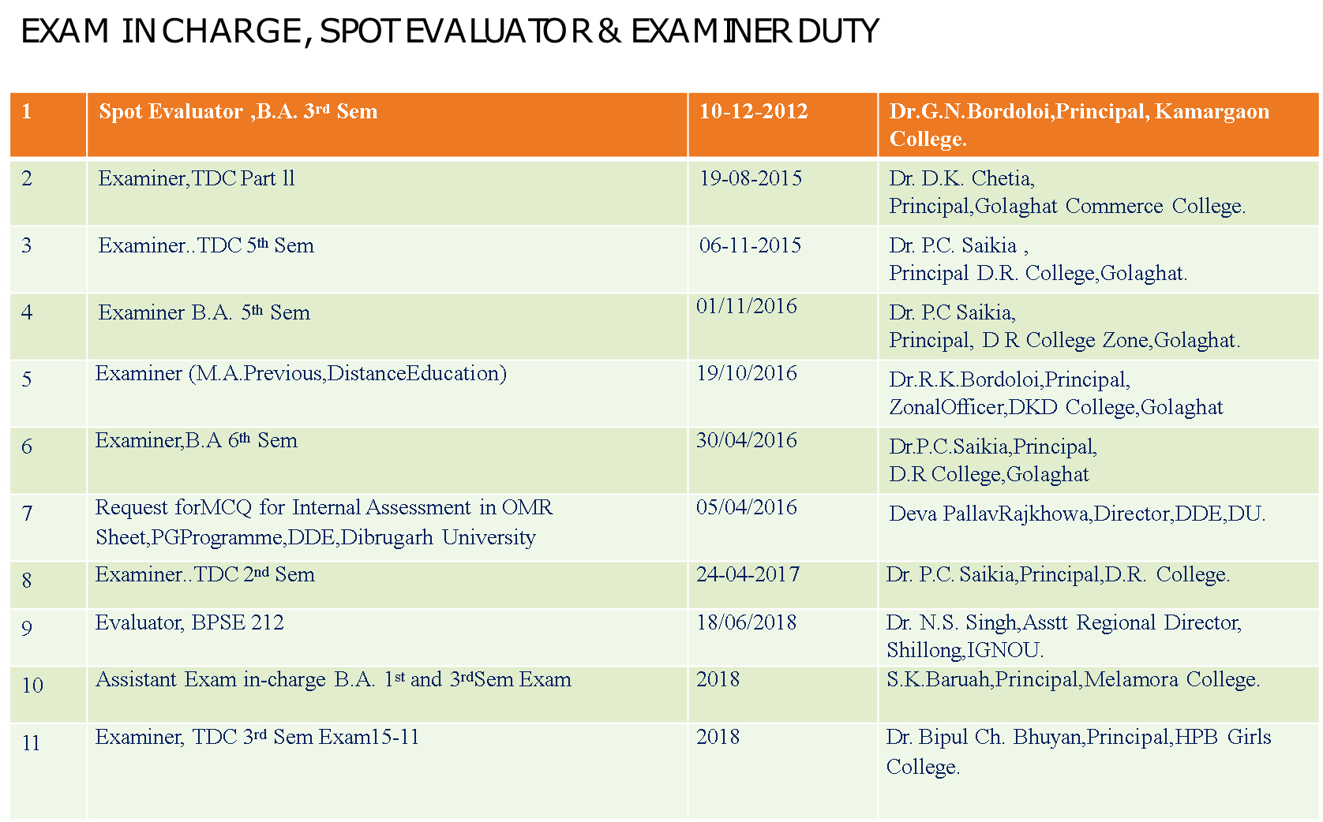

Slide 7
EXAM IN CHARGE, SPOT EVALUATOR , INVIGILATOR & EXAMINER DUTY : 2021-22
Sl. No | Activities | Date | Authority
1 | Exam In charge (1st, 3rd Sem) | 10/08/2021 | S.K.Boruah,Principal, Melamora College.
2 | Examiner..B.A. 5th Sem | 24/04/2021 | Dr.P.C.Saikia,Principal, ZonalOfficer,D.R.College.
3 | Exam in charge | 18/02/2021 | S.K.Boruah,Principal,Melamora College.
4 | Exam in-charge, B.A.1st Sem CBCS Exam | 01-02-2022 | S.K.Baruah,Principal, MelamoraCollege.
5 | Examiner (B.A. 5th Sem. CBCS Exam.) | 24-03-2022 | Dr. J. Gogoi, Principal, J.D.S.G. College, Bokakhat
6 | Invigilator Duty 1st, 2nd, 3rd, 4th ,5th & 6th Sem Non CBCS/CBCS Exam | 2021-22 | S.K.Baruah,Principal, MelamoraCollege.
7 | Examiner Duty (B.A. 1st Sem ,CBCS Exam) | 24-02-2022 | Dr. P.C. Saikia,Principal, D R College,Golaghat.
8 | Assistant Exam in-charge (B.A. 1st Sem CBCS Exam) | 10-08-2022 | S..Boruah,Principal,Melamora College

Slide 8
EXAM IN CHARGE, SPOT EVALUATOR ,
INVIGILATOR & EXAMINER DUTY : 2022-23/23-24
1 | Exam in-charge (B.A 1st Sem,CBCS Exam) | 18-02-2022 | S.K.Boruah,Principal,Melamora College.
2 | Examiner Duty (B.A. 1st Sem ,CBCS Exam) | 24-02-2022 | Dr. P.C. Saikia,Principal, D R College,Golaghat.
3 | Assistant Exam in-charge (B.A. 1st Sem CBCS Exam) | 10-08-2022 | S..Boruah,Principal,Melamora College
4 | Exam in –charge (B.A.1st Sem CBCS Exam) | 01-02-2022 | S.K.Boruah,Principal,Melamora College
5 | Paper Examiner (B.A. 5th Sem CBCS Exam) | 24-03-2022 | Dr. J Gogoi,Principal,JDSG College,Bokakhat.
6 | Assistant Exam in ChargeB.A 1st, 3rd & 5th Sem | Sessional Exam -2023 | Melamora College
7 | Exam in Charge 1st Sem FYUGP Exam 2024 | 16-11-2023 | Melamora College
8 | Exam in Charge CBCS Exam 2nd SEM 2024 | 03-05-2024 | Melamora College
7 | Invigilator Duty 5th sem CBCS Exam-2024 | 22-11-2024 | Melamora College
7 | Exam in ChargeB.A 3rd Sem FYUGP Exam- | December, 2024 | Melamora College

Slide 9
EXAMINEE, SCRUTINIZER & INVIGILATOR
1. | Examiner | B.A 1st Semester Examination | 2023
2 | Scrutinizer | B.A 1st Semester Examination | 2023
3 | Examiner | B.A 2nd Sem FYUGP Exam | 2024
4 | Scrutinizer | B.A 2nd Sem FYUGP Exam | 2024
5 | Examiner | B.A 1st Semester Exam | 2024
6 | INVIGILATOR | B.A 6TH Sem CBCS Exam | 2023
7 | INVIGILATOR | B.A 4TH Sem FYUGP Exam | 2023
8 | INVIGILATOR | B.A 2nd Sem FYUGP Exam | 2024
9 | INVIGILATOR | B.A 4TH Sem CBCS Exam | 2024
10

Slide 10
Presentation in Seminar/Conference with paper:
Presentation in Seminar/Conference with paper:
Sl.No | Title of the Paper | Title of the Seminar | Organized by | Sponsored by | Level of Seminar | Date
1. | Bharatar Swadhinata Andolanat Golaghat r Melamora Gaon r Muktijodha Sakalar abodan | Retrospection of Indian Freedom Movement: Exploring Unsung Heroes of Assam. | IQAC, Sarupathar College | ICHR | National | 12th & 13th September 2022
2. | Prospect for Sustainable Global Growth and Indian Leadership At G20—Opportunities and Challanges | Prospect for Sustainable Global Growth and Indian Leadership At G20 | Government post Graduate College OBRA, Sonebhadra, UP, India |  | International | 3rd March 2023
3. | Importance of Women in Organizing Society | The North-East Women in Socio -Economic Development of India | Dept. of Assamese & IQAC Melamora College |  | National | 11th November 2023

Slide 11
Sl.No | Title of the Paper | Title of the Seminar | Organized by | Sponsored by | Level of Seminar | Date
4. | Sexual Harassment of Women at workplace (prevention,Protection and Redressel) Act-2013 | Contemporary ender Issues: Prospects & Challenges. | Dept. of Pol Science & Dept. of English, Ledo College | ICT Academy | National | 24th July 2022
5. | Human Rights and Social Justice: Pathways to Equity and Inclusion | Multidisciplinary Perspective for Improving Sustainability 2024 | Kunda Kunda Kahan Digambar Jain College |  | National | 23rd June 2024
6. | Sustaining Tomorrow: Interdisciplinary Solutions For a Resilient Tomorrow | Research for Sustainable Future-Multidisciplinary Approaches. | Global Bridge College, Wolaita, Ethiopia |  | International | 18th August, 2024

Slide 12
Presentation in Seminar/Conference with paper:
Sl.No | Title of the Paper | Title of the Seminar | Organized by | Sponsored by | Level of Seminar | Date
7. | Navigating New Horizon : Emerging Trends in Humanities & Social Science Research | Imerging Trends in Humanity & Social Science Research | Baba Khetanath Mahila Teacher Training College | Baba Khetanath Mahila Teacher Training College | International | 11-02-2024
8. | Transforming Education: The Role of Artificial Intelligent in Shaping the Future of Learning | New Horizon in Multidisciplinary Academic Research 2024 | Ramananda Teacher Trtaining College,Kota Rajasthan | Ramananda Teacher Training College,Kota Rajasthan | International Conference | 07-07-2024
9.

Slide 13
NATIONAL WORKSHOP: 2021-22
Sl. NoLI |  | Title of the Workshop |  | Duration | Organized by |  |  | Date
1 |  | Human Rights Education: Issues and Challenges in North East India |  | One Week | Centre for Ethnic Studies and Research (CESR) Guwahati in Collaboration with Pol Sc. Dept, Moridhol College and Pol Sc. Dept. Marangi College. |  |  | 7-13 August 2021
2 |  | Workshop On MOOCs |  | One Week | HRDC,MIZORAM UNIVERSITY |  |  | 11-17 February , 2022
3 |  | Redesigned Assignment and Accreditation Framework of NAAC |  | One Day | Joya Gogoi College,Khumtai in collaboration with IQAC,Melamora College |  |  | 05 March,2022
4 |  | National Workshop on Human Rights: A North- East Perspectives | National | 12-03-2016 – 17- 08-2016 | National Workshop on Human Rights: A North East |  |  | 12-03-2016 – 17- 08-2016

Slide 14
5 | UGC Sponsored Online National Workshop on NEP-2020 | University | 17-06-2022 | National Workshop on NEP-2020 Organized by UGC, HRDC, Sambalpur University
6 | Workshop on Effective Teaching | National | 16-08-2022 – 22-08-2022 | Industry-Academic Innovative Practices Organized by Bharat Digital Academy,Aligarh
7 | Online Workshop on Data Analysis With SPSS | National | 22-08-2022 – 23- 08-2022 | Workshop on Data Analysis with SPSS Organized by Bharat Digital Academy,Aligarh
8 | The Technicalities of Writing Research Papers and Preparation of Research Proposals | Regional/State | 20-05-2023 | Industry-Academic Innovative Practices Organized by Furkating College,
9 | Workshop on Implementation of Four Years Undergraduate Programme(FYUGP) | Regional/State | 09-06-2023 | Workshop on Implementation of Four Years Undergraduate Programme(FYUGP) Dibrugarh University & IQAC, HPB College

Slide 15
SL NO | BOOK NAME | AUTHOR | PUBLISHER | PUBLISH DATE | ISBN | TITLE
1 | Dimensions of | Dr. | Kushal | 08-09- | 978-93-5105-260-9 | Human Rights Education in
 | Multidisciplinary Research | Ripunjay | Prakashan,Ghy | 2016 |  | India
 | Studies | Sonowal
 |  | Dr. Ajit
 |  | Goswami

Slide 16
2 | Luit Paror Shrestha Anugalpa | Dip | Doyang | 10-02- | 978-81-939793-1-0 | Salyut,Paribartan,Bondha
 |  | Hastings | Publication,Golaghat | 2021
 |  | Bori
 |  | Pollabika
 |  | Boruah
 |  | Karishma
 |  | Saikia
3 | Contemporary Gender | Madhab | Ledo | 09-08- | 978-93-91953-44-7 | Sexual Harasment of Women
 | Issues:Prospects and Challanges | Dayal | College,Tinsukia | 2022 |  | at Workplace
 |  | Dutta
 |  | Pari Gogoi
4 | MILLENIALS | Protim | Publication Cell, | 09-12- | 978-93-5773-808-8 | Ilegel Migration in Assam: A
 |  | Saikia | Melamora College | 2022 |  | Statistical Analysis
 |  | Sumi Bora
5 | Melamoriyan | Rituporna | Publication Cell, | 10-04- | 4583/ISBN/2023/A | Arihana, Sampad
 |  | Gogoi | Melamora College | 2023 |  | (Micro story)
6 | Indian Freedom | S Dutta | Santi | 20-09- | 987-93-9248-300-4 | Bharotor Swadhinata
 | Movement:Exploring the | Dr. R | Pustakalaya,Golaghat | 2023 |  | Andolonot Golaghator
 | Unsung Heroes of Assam | Khanikar |  |  |  | Melamora Gaonor Mukti
 |  |  |  |  |  | Jodha hokolor Abodan
7 | Seuji Melamora (Book) | Biswajit | Probhati | 15-07- | 978-93-5913-465-9 | Seuji Melamora:A brief
 |  | Bora | Printers,Golaghat | 2023 |  | description about Melamora
 |  |  |  |  |  | Gaon with different aspects of
 |  |  |  |  |  | Melamora Rural Tourism
8 | Gajali | Protim | M. S | 24-12- | 978-81-968559-7-0 | Bhuk, Hisap,Dhul(Micristory)
 |  | Saikia | Everywhere,Ghy | 2023
 |  | Achinta
 |  | Dutta

Slide 17
9 | MILLENIALS | Durlabh | Publication Cell, | 29-12- | 978-81-967096-5-5 | Gandhibador Prasongikota
 |  | Bori | Melamora College | 2023
 |  | Bhaskar
 |  | Jyoti Nath
10 | BEEKSHA | Jugal Jyoti | ACTA,Golaghat | 30-12- | ISSN | Melamora Rural Tourism
 | Peer Reviewed Journal | Bora | Zone | 2023 | 2278-4128 | Centre,Golaghat,Assam:A
 |  |  |  |  |  | Study of Economic
 |  |  |  |  |  | Empowerment of Youths
11 | Sustainable Global Growth and | Dr. | Vijay Prakashan | 30-12- | 987-93-95430-16-6 | Prospects for Sustainable
 | India at G-20 | Mohendra | Mandir,Varansi | 2023 |  | Global Growth and Indian at
 | (National Publication) | Prakash |  |  |  | Leadership at G-
 |  | Dr. |  |  |  | 20:Opportunities and
 |  | Kishore kr. |  |  |  | Challenges
 |  | Sing
12 | Poonam Shodh Rachna | Dr. Neeraj | Poonam Academic | 03-03- | E-ISSN | Melamora Rural Tourism
 | Peer Reviewed & Refereed | Kumar | Research Foundation | 2024 | 2456-5563 | Centre,Golaghat,Assam:Youth
 |  | Sarma |  |  |  | Development and
 |  |  |  |  |  | Empowerment :A Brief
 |  |  |  |  |  | Overview
13 | Poonam Shodh Rachna | Dr. Neeraj | Poonam Academic | 01-02- | E-ISSN | Navigating New
 | Peer Reviewed & Refereed | Kumar | Research Foundation | 2024 | 2456-5563 | Horizons:Emerging bTrends
 |  | Sarma |  |  |  | in Humanities and Social
 |  |  |  |  |  | Science Research
14 | BDRU International Journal of | Dr. Neeraj | Baba Ramdas | 01-06- | E-ISSN | Human Rights and Social
 | Multidisciplinary Research | Kumar | Udaseen Shkshan | 2024 | 2455-278X | Justice:Pathways to Equity
 |  | Sarma | Sansthan |  |  | and Inclusion

Slide 18
 | International Journal of Noval Research | IJNRD.ORG | IJNRD.ORG | 09-09-2024 | ISSN: 2456-4184 | The Impact of Digital Media on the Cultural Identity of North East India
15
10
 | International Journal of Research And An alytical Review | IJRAR | R. B. JOSHI | 13-09-2024 | E-ISSN: 2349-5138 | Melamora:A Treasure Trove of Rural Tourism in Golaghat,Assam

Slide 19
PROFESSIONAL DEVELOPMENT
SL.NO | PROGRAMME | ORGANIZED BY | DATE | TITLE
1 | Orientation Programme | UGC HRDC Mizoram University | 02-11-2021 | UGC HRDC, Mizoram University 33rd Orientation Programme
2 | Capacity Building Programme | Melamora College | 14-03-2022 | Weeklong Capacity Building on Computer Basics
3 | Short Term FDP | HRDC & AMET BUSINESS SCHOOL | 30-01-2023- 04-02-2023 | Short Term FDP on Ethics in Academic Research Writing
4 | Faculty Development Programme | IQAC & Digitel Cell,Kanya Mahavidyalaya in collaboration with ICT Academy | 26-06-2023- 02-07-2023 | One Week Faculty Development Programme on Creative Thinking
5 | REFRESHER COURSE Grade A | UGC HRDC, Mizoram University | 22-08-2023- 04-09-2023 | UGC HRDC ,Mizoram University
6 | Short Term Course on NEP | MM-TTC, Tezpur University | 19-02-2024- 28-02-2024 | Short Term Course on NEP Orientation & Sensitization under MMTT of UGC

Slide 20
PARTICIPATION IN COLLEGE ACTIVITIES:-
2021-22
Sl. No | Committee / Cell | Membership
1 | Students Admission Committee | Member
2 | College Students Union | Game in-Charge
3 | College Teachers’ Unit | Secretary
4 | Students Support and Progression CELL | Member
5 | Anti Ragging Committee | Member
6 | Career Counselling and Guidance CELL | Convener
7 | Exam Controller for Internal Assessment and End Semester | Member
8 | Election CELL | Member
9 | Alumni CELL | Member
10 | Internal Complain Committee | Member
11 | Health and Awareness Committee | Member

Slide 21
PARTICIPATION IN COLLEGE ACTIVITIES:-
Sl. No | Committee / Cell | Membership
12 | College Environment Cell | Member
13 | NEP Task Force | Member
14 | College Teachers’ Unit | Secretary/President
15 | Editorial Board of the College | Member
16 | Academic & SLC Module in Samarth | Module co coordinator
17 | Admission Committee | Convener
18 | DIGITAL Learning Cell | Nodal Officer
19 | KKHSOU Study Centre | Member
20

Slide 22
PARTICIPATION IN GOVT. ACTIVITIES-
Sl. No | DUTY | RESPONSIBILITY
1 | ASSEMBLY ELECTION -2021 | PRESIDING OFFICER
2 | GENERAL ELECTION TO LOK SABHA 2024 | PRESIDING OFFICER
3 | GUNOTSAV DUTY - 2021 | External Evaluator
4 | GUNOTSAV DUTY - 2023 | External Evaluator
5

Slide 23
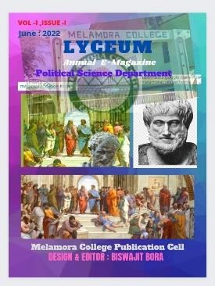
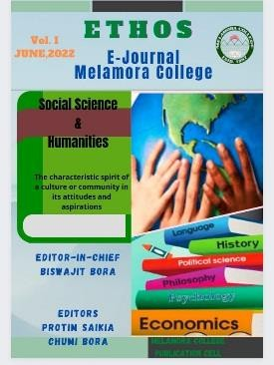
College E-Magazine : WISDOM ( Editor )
E-Magazine Link : https://heyzine.com/flip-book/d672639df8.html
Departmental E-Magazine: LYCEUM( Editor )
E-Magazine Link : https://heyzine.com/flip-book/1ba96c1b85.html
E-Journal Melamora College : ETHOS
E-Journal Link :
( Editor in Chief )

Slide 24
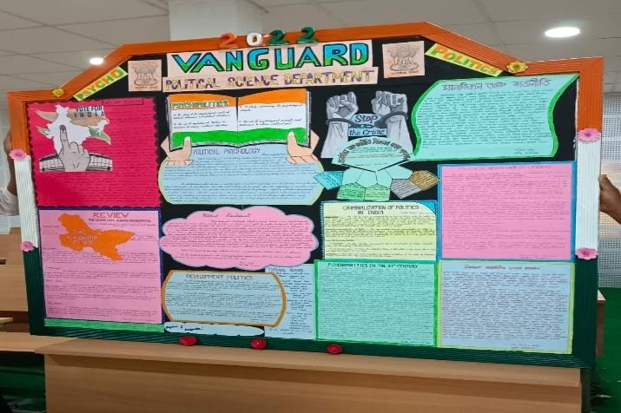
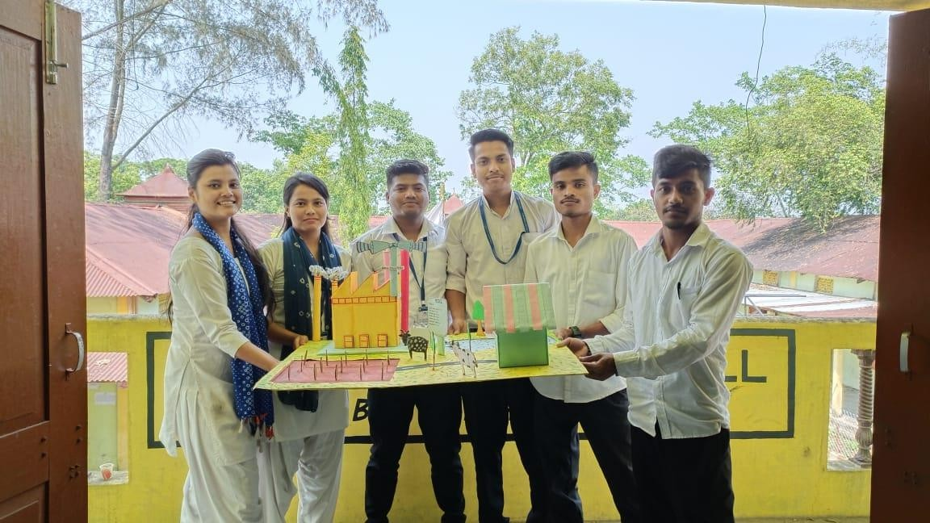
Departmental Wall Magazine: : VANGUARD
( President )
Biswajit Bora Assistant Professor
Department of Political Science Melamora College
Departmental Project on “Air and Water Pollution”
( Guide Teacher)
Biswajit Bora
Assistant Professor
Department of Political Science Melamora College

Slide 25
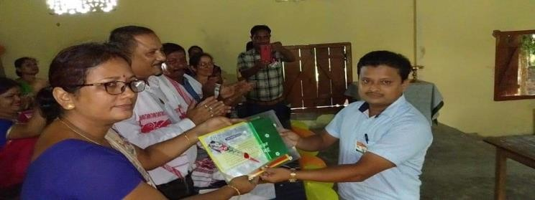
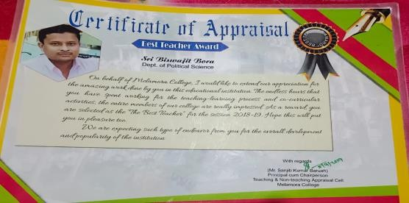
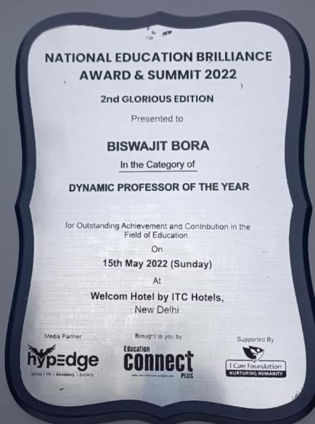
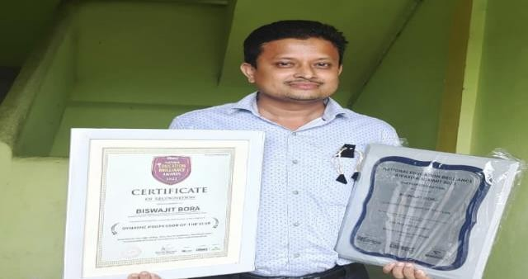
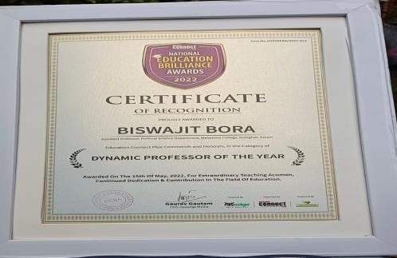
AWARD :
BEST TEACHER AWARD 2018-19
Awarded by : Melamora College Appraisal and Non Appraisal Cell
NATIONAL EDUCATION BRILLIANCE AWARD:2022
DYNAMIC PROFESSOR OF THE YEAR-2022
Awarded by : Hypedge Media, Education Connect Plus & I Can Foundation

Slide 26
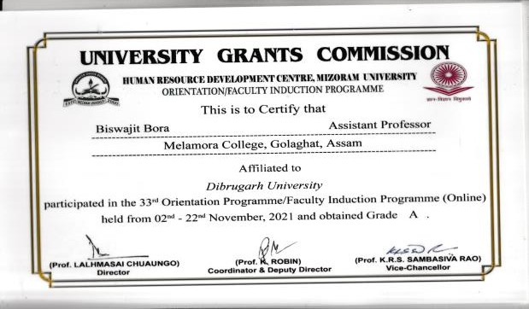
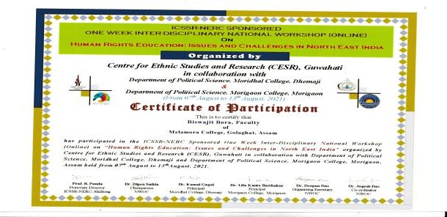
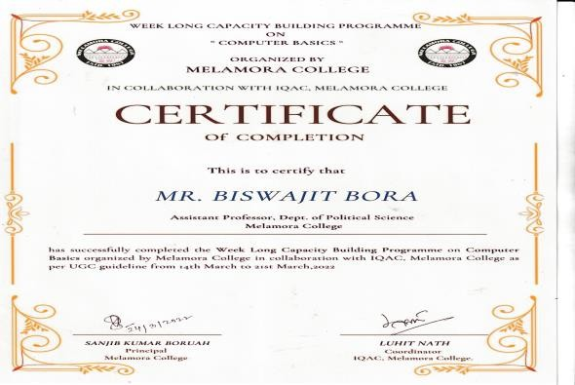
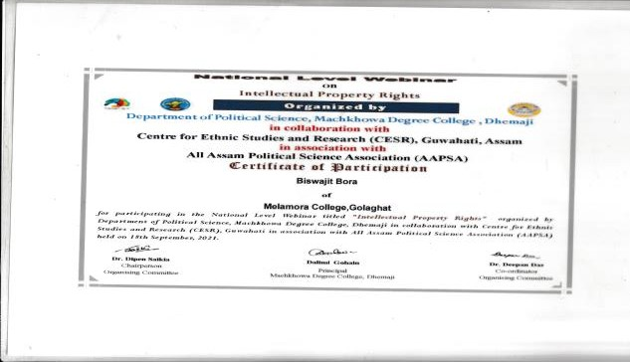
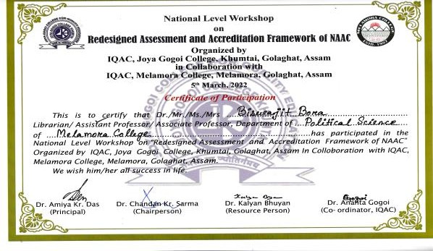
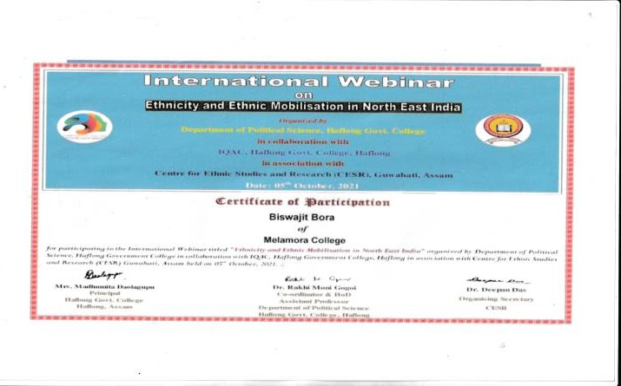
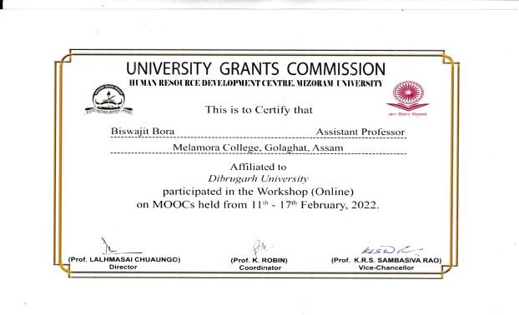
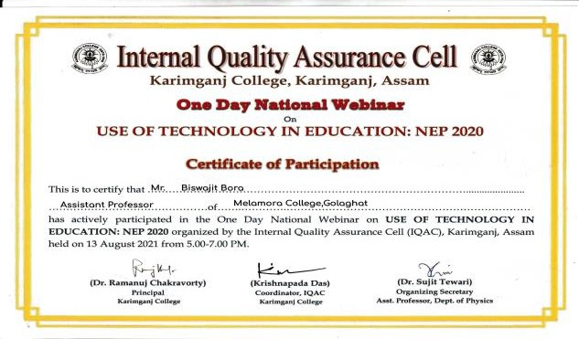
Certificates of National Workshop / Seminar/ Webinar etc.

Slide 27
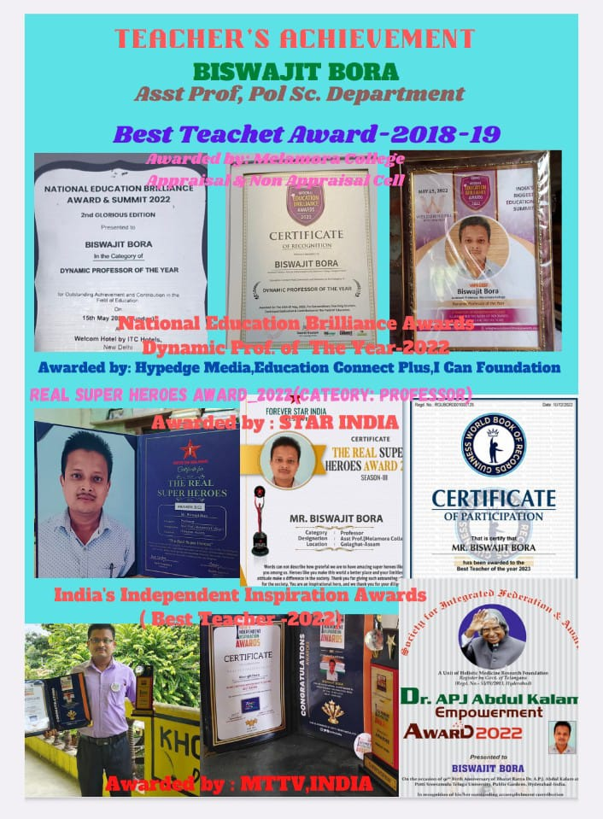

Slide 28
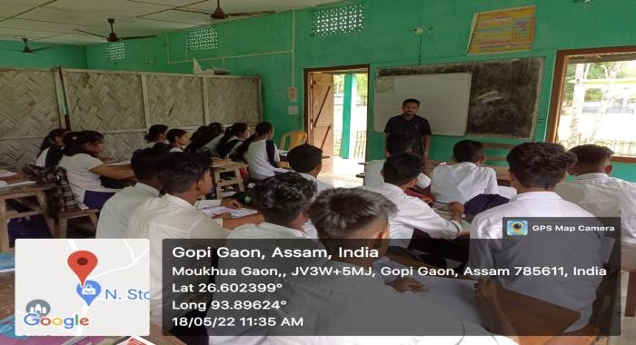
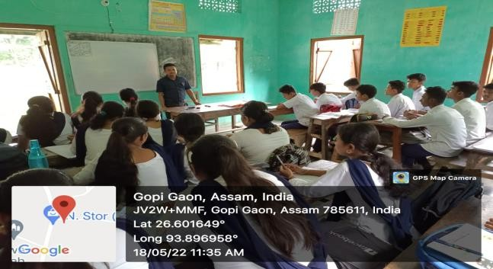
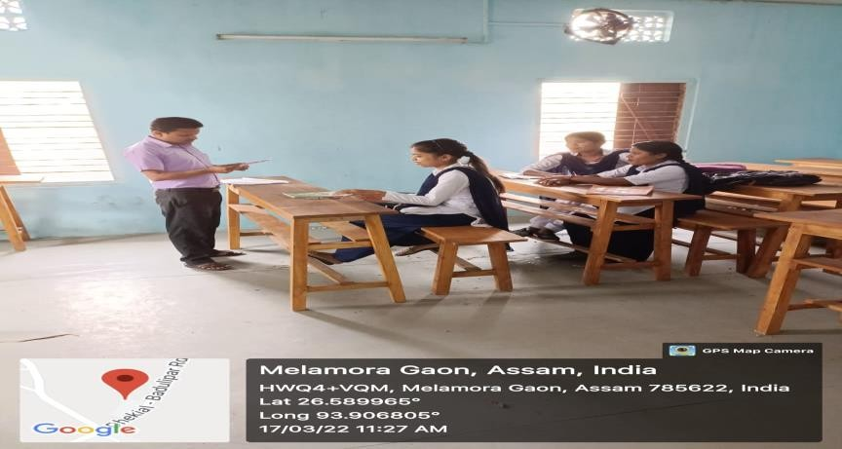
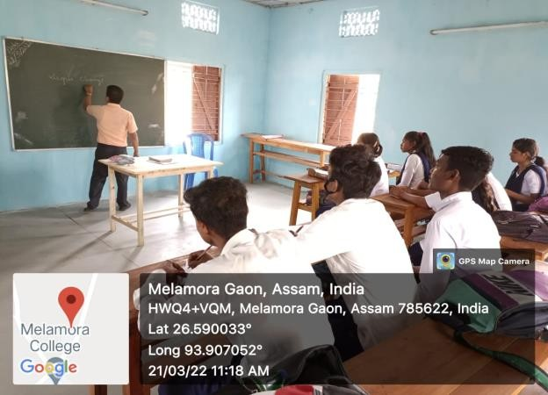
EXTENSION ACTIVITIES : 2022-23
Guest Teacher at Mowkhowa High School IX & X
Free Remedial Class at Melamora High School(English for Class IX to XII)

Slide 29
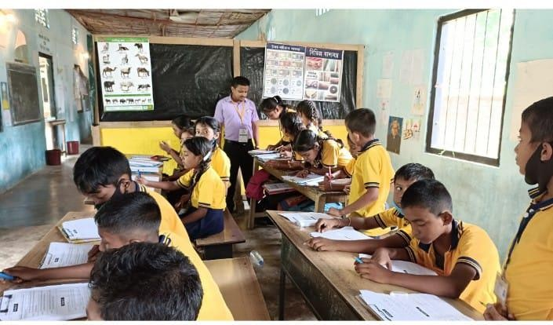
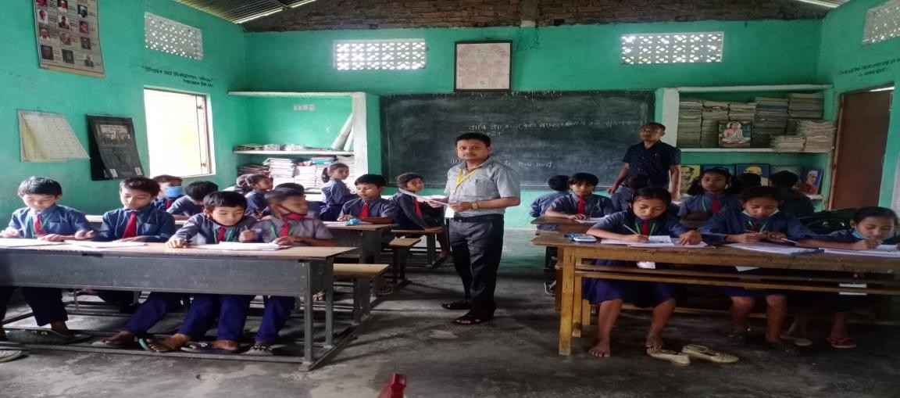
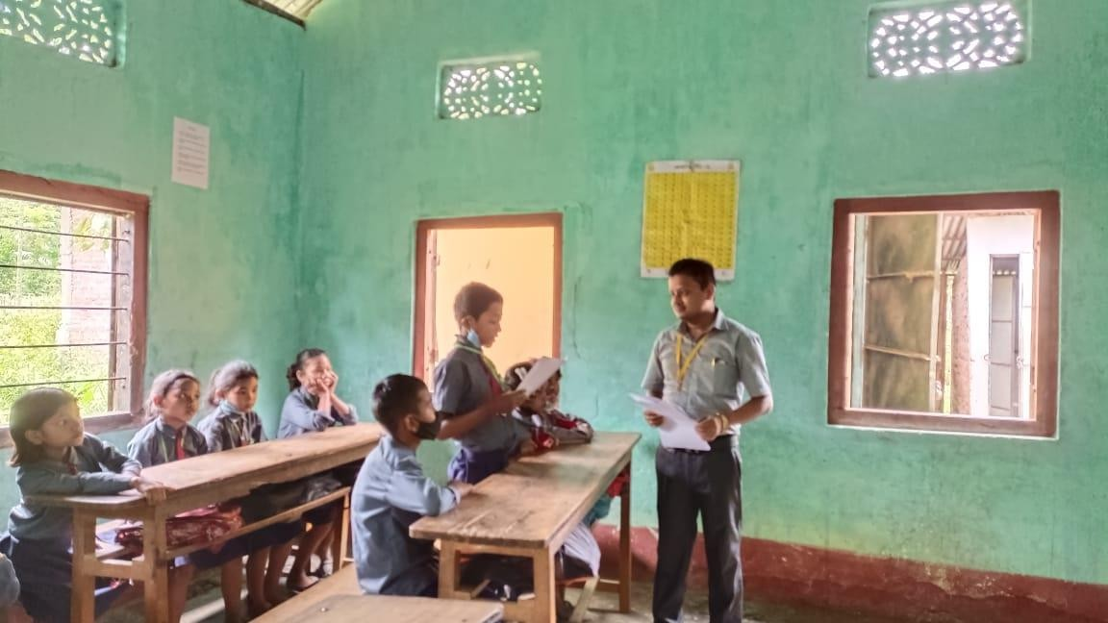
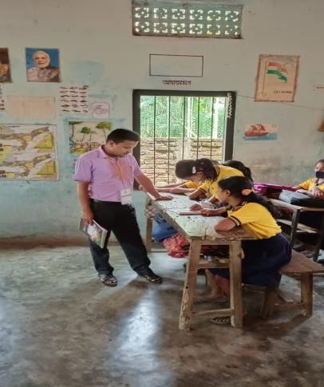
Teaching in Various L.P. Schools : 2021-22

Slide 30
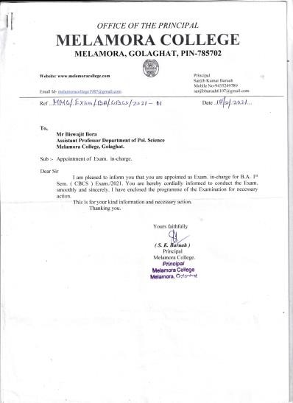
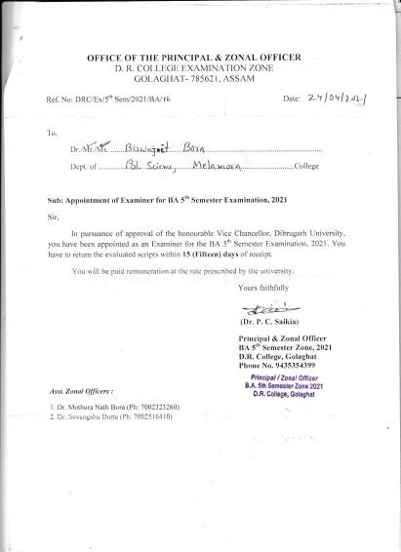
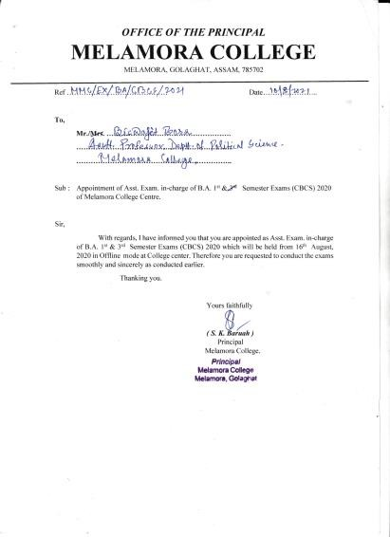
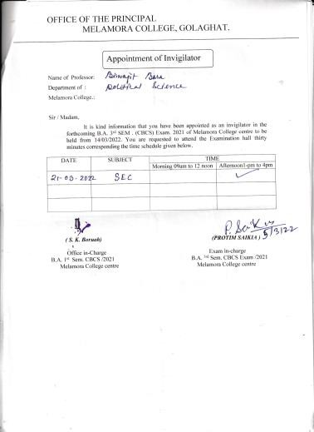
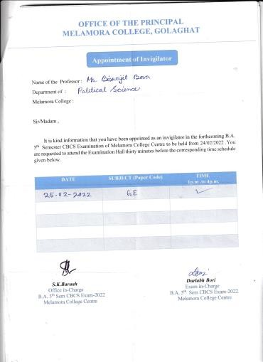
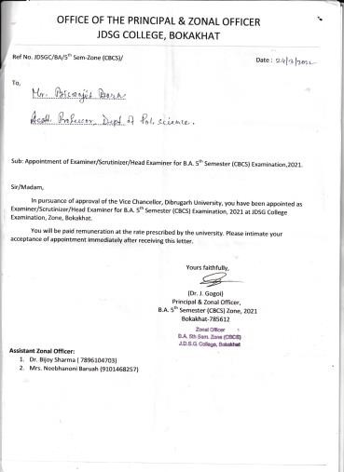
Exam. In- charge, Evaluator, Invigilator etc.

Slide 31
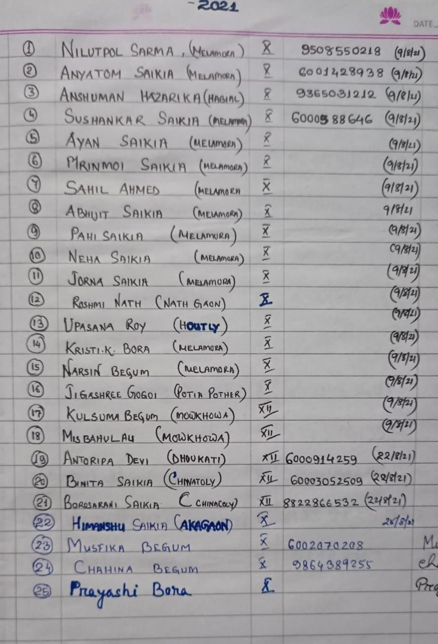
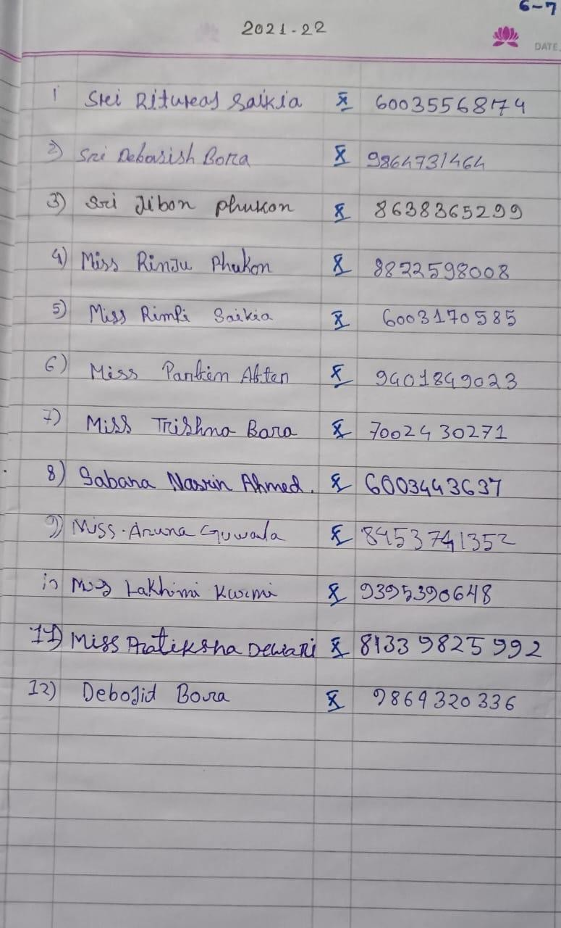
Free Remedial / Tutorial Class :2021-22
Students of Class IX & X belong to below poverty line ( B.P.L)

Slide 32
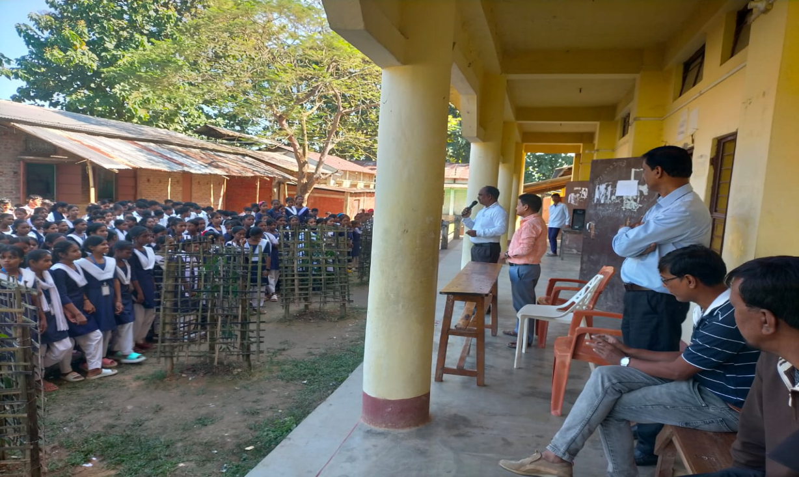
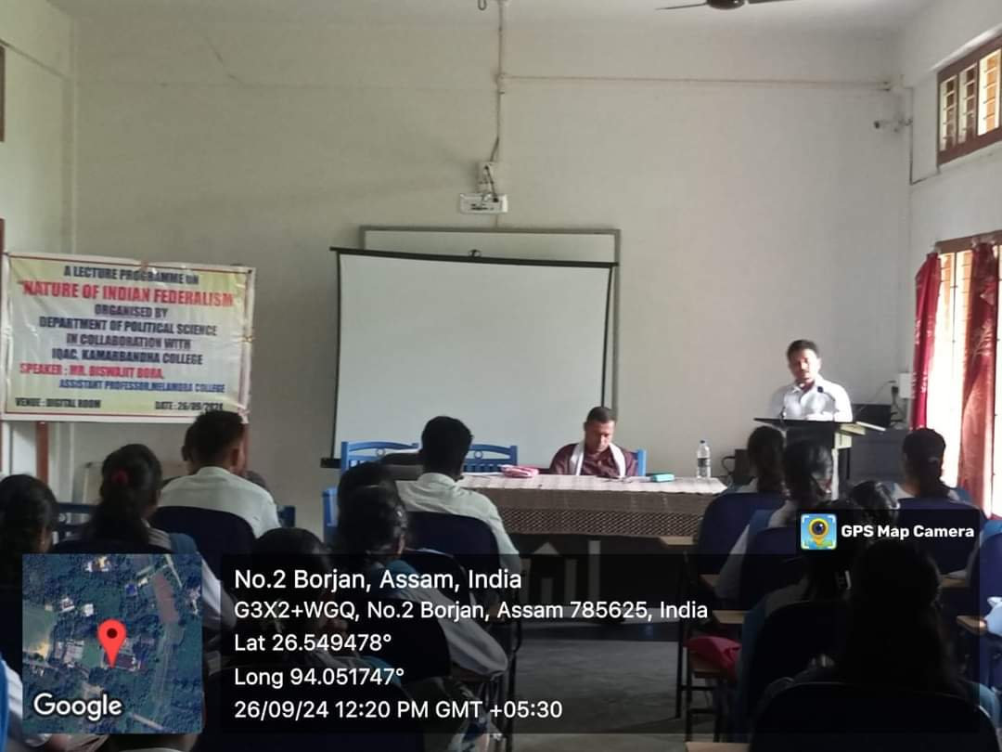
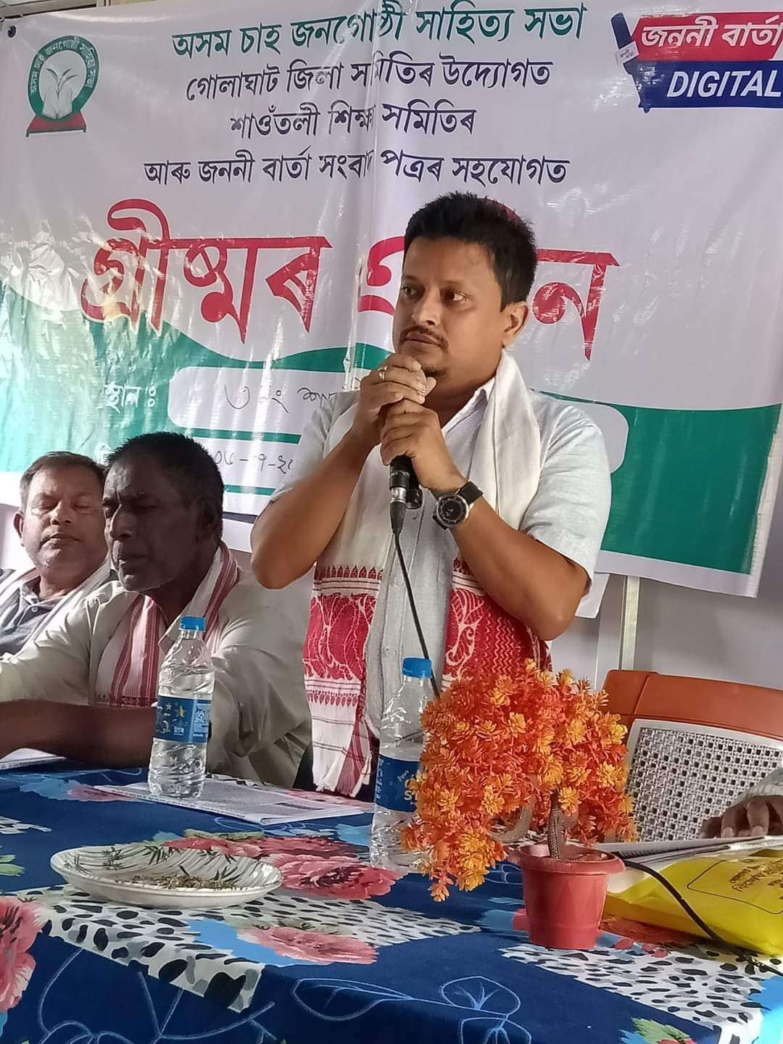
EXTENSION ACTIVITIES : 2024

